Slide 1
COMP4332/RMBI4310
Big Data Mining and Management
Advanced Data Mining for Risk Management and Business Intelligence (2025 Spring)
Tutorial 4: Neural CF and Wide & Deep Learning
TA: Chunyang LI (cliei@connect.ust.hk)

Slide 2
1 Neural CF

Slide 3
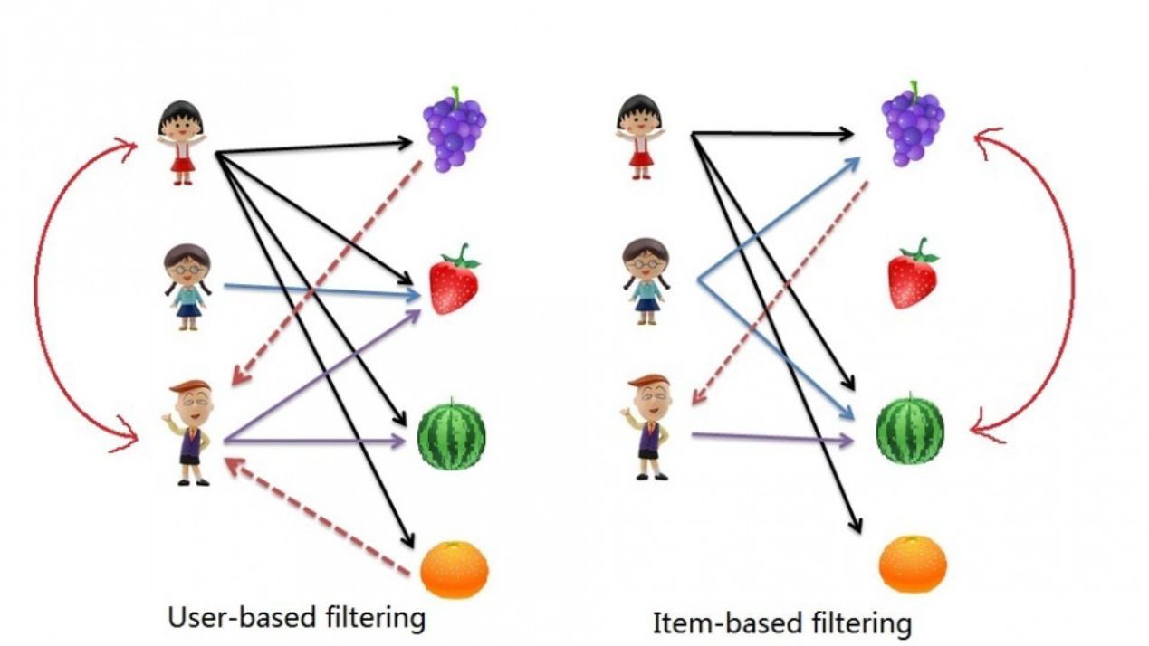
Recap: user CF / item CF

Slide 4
Limitations of traditional matrix factorization
Linear Assumption
MF models user-item interactions as a dot product of latent vectors.
Fails to capture complex, non-linear patterns in real-world data.
Fixed Interaction Function
Dot product restricts flexibility.
Shallow Representation Learning
Performs poorly with sparse data.
Latent vectors are learned via linear decomposition, limiting expressiveness.

Slide 5
Neural Collaborative Filtering (Neural CF) [1]
Core:
Replace dot product in MF with a neural network to learn arbitrary interaction functions.
Key Components:
User/Item Embeddings: convert IDs into dense vectors.
Interaction Layer: Neural network (e.g., MLP) learns non-linear user-item relationships.
[1] He, X., Liao, L., Zhang, H., Nie, L., Hu, X., & Chua, T.S. (2017). Neural Collaborative Filtering. In Proceedings of the 26th International Conference on World Wide Web (pp. 173–182). International World Wide Web Conferences Steering Committee.

Slide 6
Model Architecture
Input Layer:
User ID to Embedding layer
Item ID to Embedding layer
Neural Interaction Layers:
Multi-Layer Perceptron (MLP)
Loss Function: Mean Square Loss

Slide 7
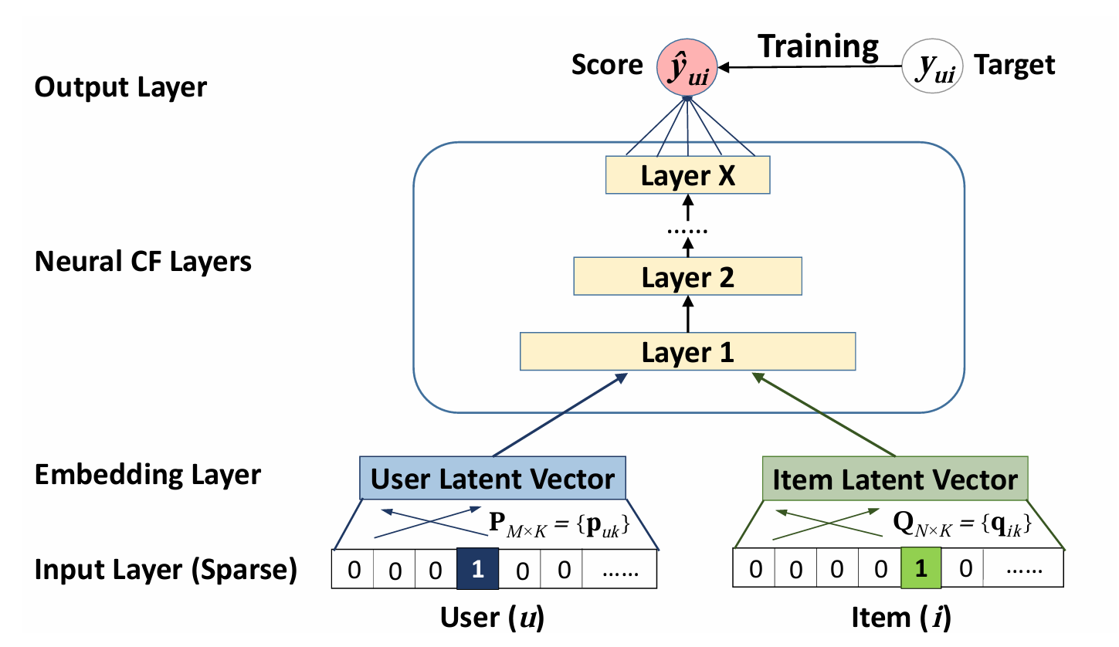
Model Architecture

Slide 8
Deep Learning Workflow (Pytorch)
Preparing data
Prepare dataset (we use custom datasets in this tutorial).
Split data into training and test sets.
Building model
Creating a model by subclassing nn.Module (usually) and define the forward() method.
Fitting the model (training)
Loss function
Optimizer
Making predictions and evaluation (inference)
Evaluation metrics
Saving and loading model

Slide 9
2 Wide & Deep Learning

Slide 10
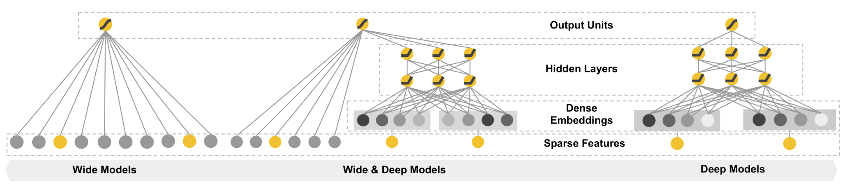
Wide & Deep Learning
Memorization
Generalization
Cheng, H., Koc, L., Harmsen, J., Shaked, T., Chandra, T., Aradhye, H.B., Anderson, G., Corrado, G.S., Chai, W., Ispir, M., Anil, R., Haque, Z., Hong, L., Jain, V., Liu, X., & Shah, H. (2016). Wide & Deep Learning for Recommender Systems. Proceedings of the 1st Workshop on Deep Learning for Recommender Systems.

Slide 11
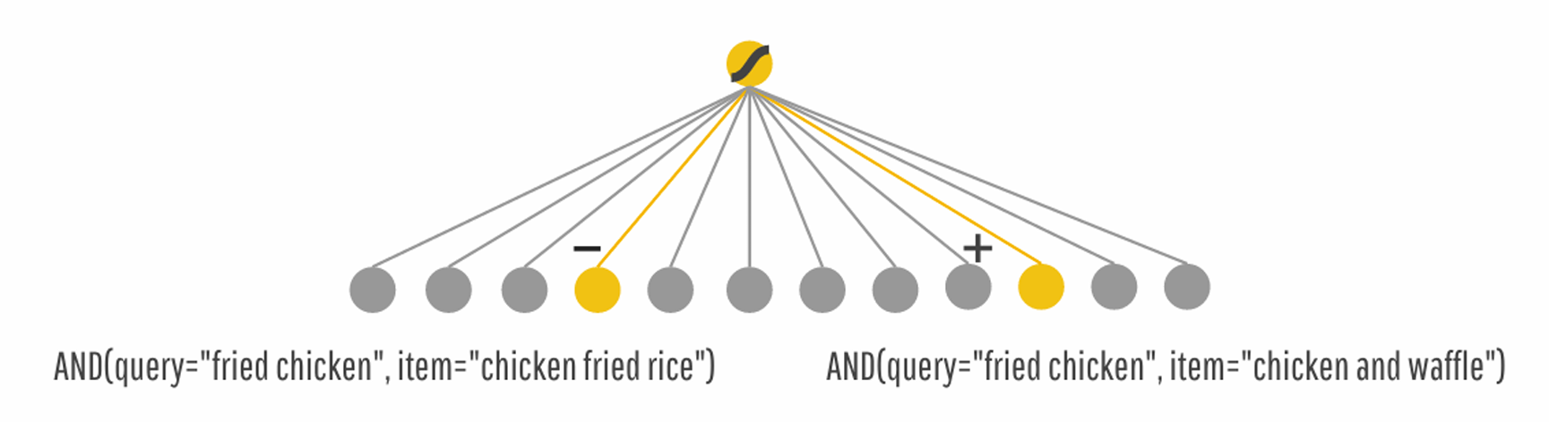
The Wide Model
Memorization
Exploiting the correlation available in the historical data

Slide 12
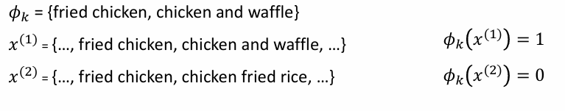
The Wide Model
Cross-product transformation:

Slide 13
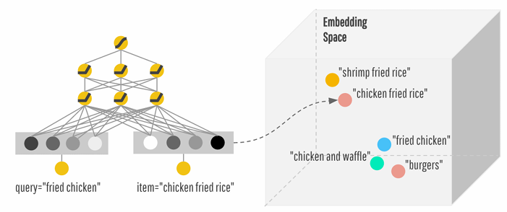
The Deep Model
Generalization
New feature combinations that have never or rarely occurred in the past

Slide 14
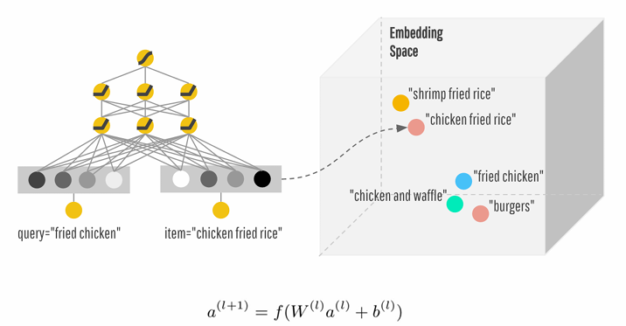
The deep model

Slide 15
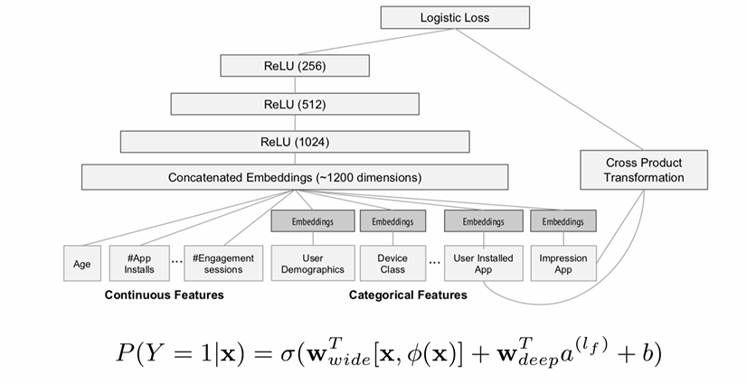
The Wide & Deep Model

Slide 16
Continuous Features
Example feature name: “average_stars”
Example feature value: 3.63

Slide 17
Deep Categorical Features
Example feature name: “item_city”
Example feature value: “Phoenix”

Slide 18
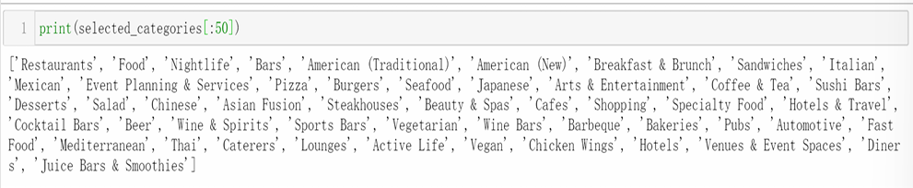
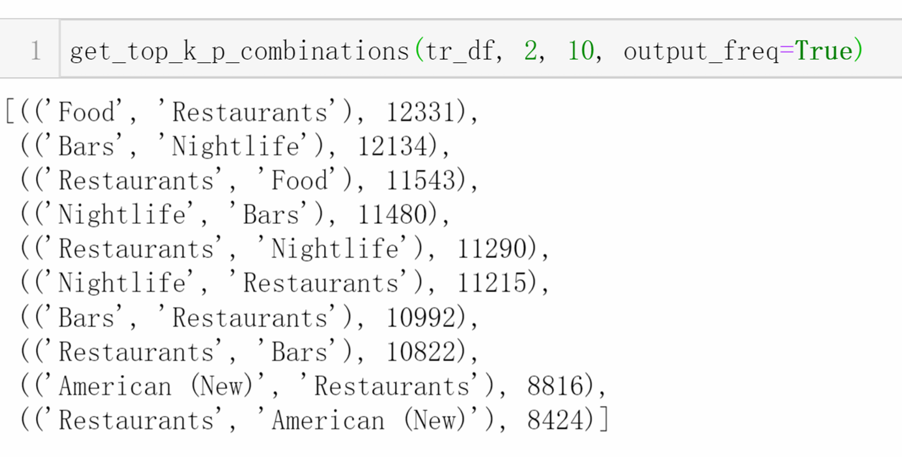
Wide Features

Slide 19
Implementation of the Rating Prediction Task
See the Jupyter Notebook.

Slide 20
Thank you

